Slide 1
Spiritual Jumper
N.L.E. presents

Slide 2
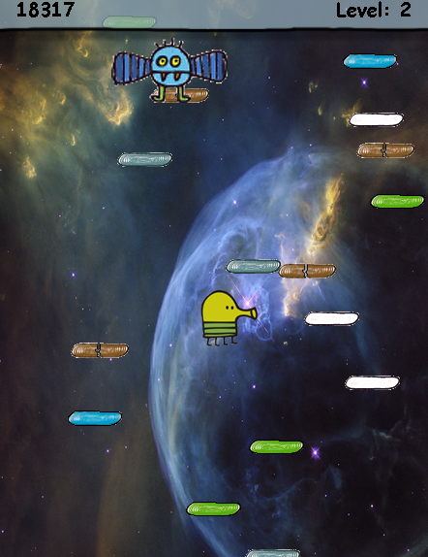
EASY, BUT ADDICTING
Spiritual Jumper is a 2D infinite vertical runner game. Players compete with friends for infinite high score. The character in game will encounter aliens and stairs traps. The player need to make strategy to choose the safe route.
The game will provide intense fun while not draining your battery fast like other current games, thanks to the concise structure.

Slide 3
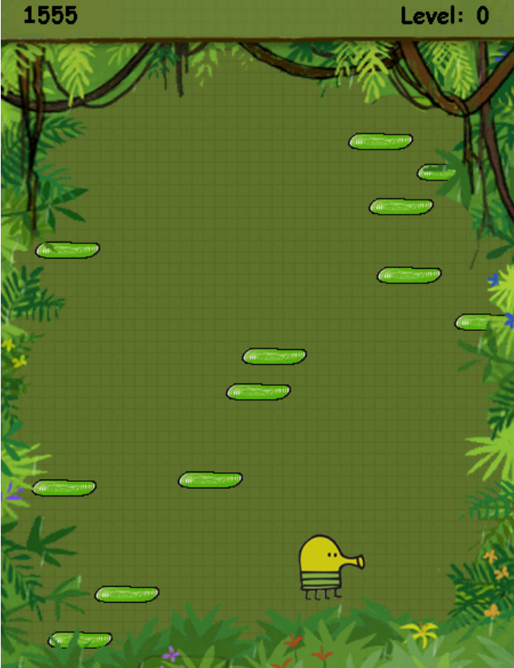
All ages, all platforms
Spiritual Jumper is a space-themed game that have little explicit content. It fits all types of audiences.
It takes little practice to play the game while players can have widely different play styles as they develop.

Slide 4
eASY CONTROL
The character will automatically move up, the users only control horizontal movement.
Avoid or shoot the alien
Use the items
Input: Arrow key to move horizontally
Space to shoot (On PC)

Slide 5
Testing
In – Game Manual Testing: Tested aspects of the game by comparing occurrences within the game with expected output.
Unit Testing: Testing the leader board function.

Slide 6
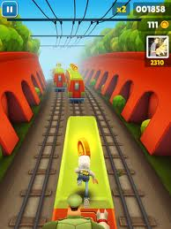
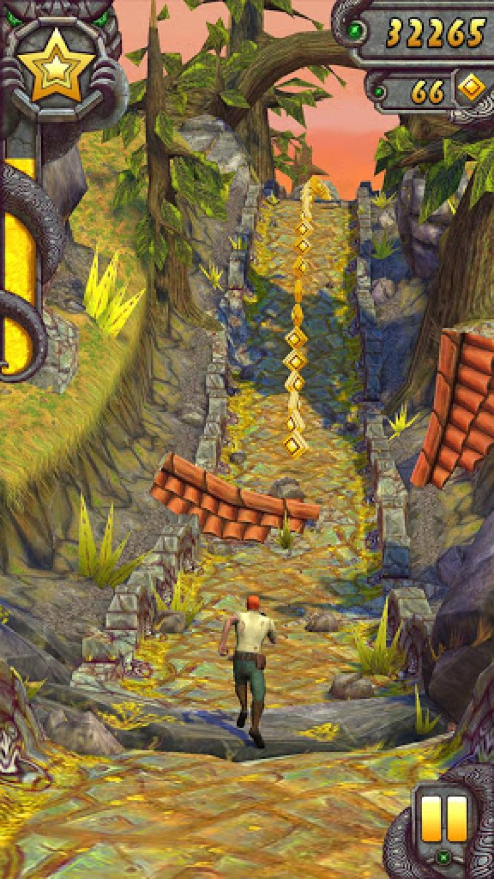

Popularity and hype
The infinite jumper/runner is a hot trend in mobile games, famous games such as :” Temple Run” , “Subway Surfers”, “Flappy Bird”, “Jetpack Joyride”.

Slide 7
conclusion
As people are spending more and more time on cell phone entertainment, it is important to develop a fun, simple game fit all types of audiences. A lot of existing game sometimes are overly complicated. It will drain your battery much faster than a simple game with concise structure. There are some games just have way too many buttons to have fun. It becomes especially difficult to play for users with smaller cell phone screens. Spiritual Jumper is a game that take little time to develop skill but you won’t get tired with it soon by keep challenging yourself for higher score. We created space theme in the game so the users will better immerse themselves in the space adventure.

Slide 8
Questions?

Slide 9
Thank you for your time!

